Slide 1
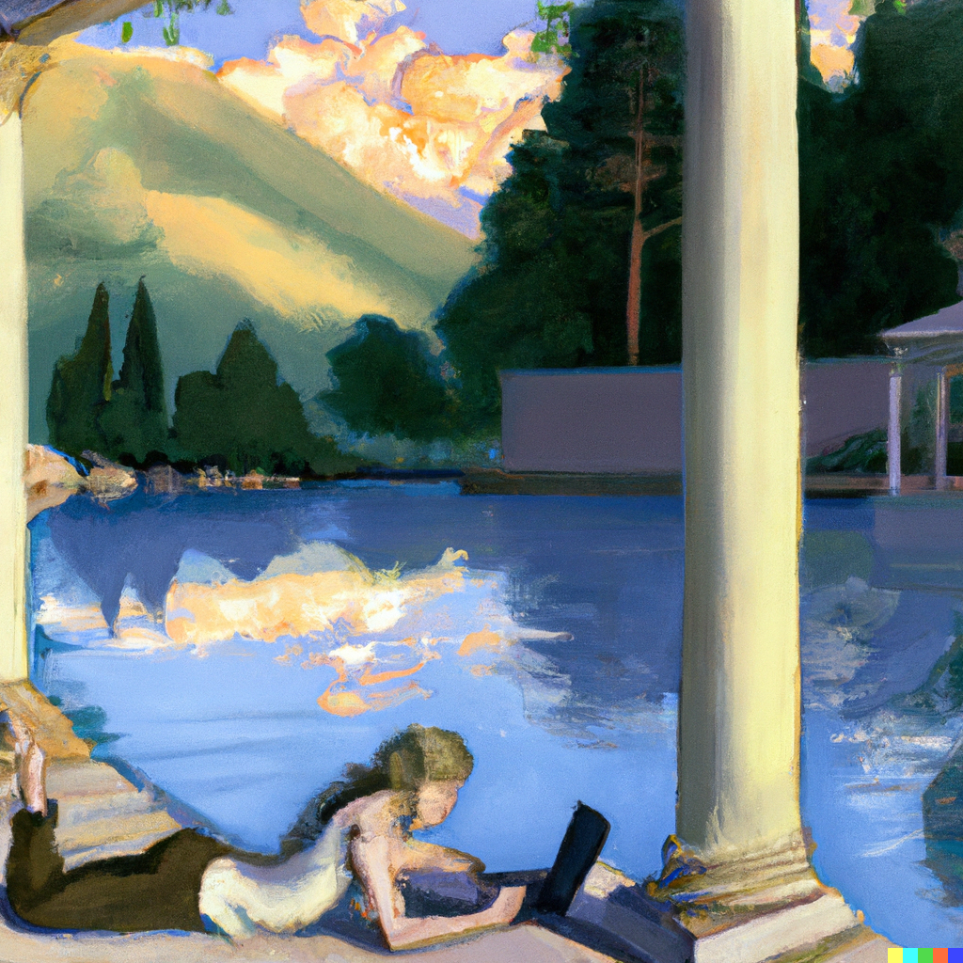
Generative Art
Two Hour Course
The Thinking Spot
September 25th, 2022
Fundraiser for Code Savvy and the IoT Hackathon

Slide 2
Agenda
Introduction – 10 minutes
Disclaimer: images generated may be “unsafe” (NSFW)
Hands On – 30 minutes
Dall-E-2
Midjourney
Stable Diffusion
Discussion
Faces, Hands, Text
Breakouts:
Technical, Artistic, Business, Other
The Future of Generative Art
Videos, named components

Slide 3
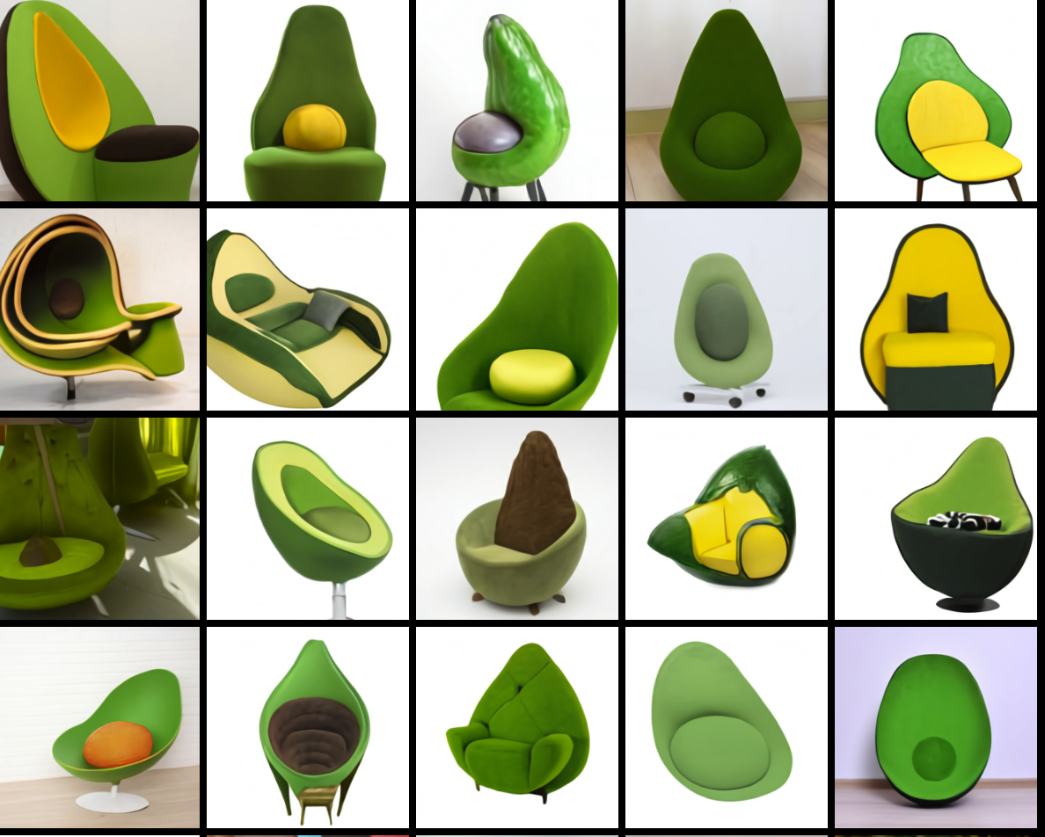
The Avocado Chair Dall-E January 2021
https://openai.com/blog/dall-e/

Slide 4
DALL-E
175B
DALL·E is a 12-billion parameter version of GPT-3 trained to generate images from text descriptions, using a dataset of text–image pairs. We’ve found that it has a diverse set of capabilities, including creating anthropomorphized versions of animals and objects, combining unrelated concepts in plausible ways, rendering text, and applying transformations to existing images.

Slide 5
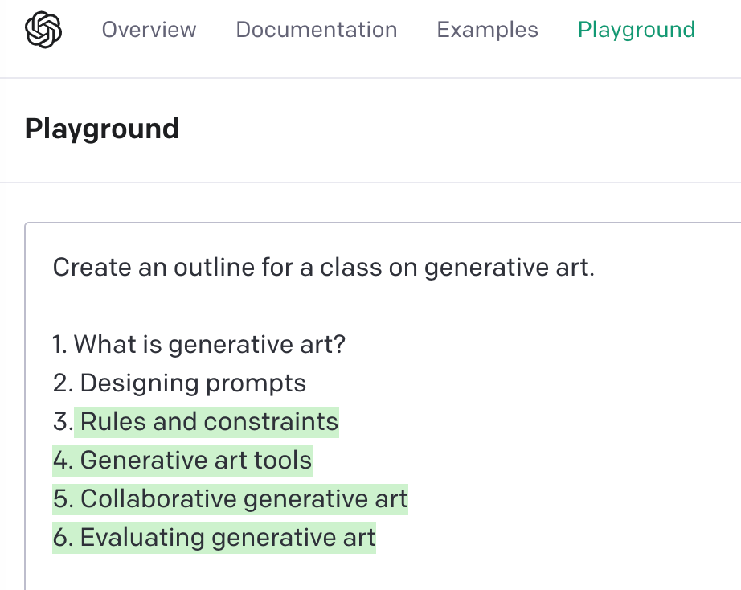
Prompt

Slide 6
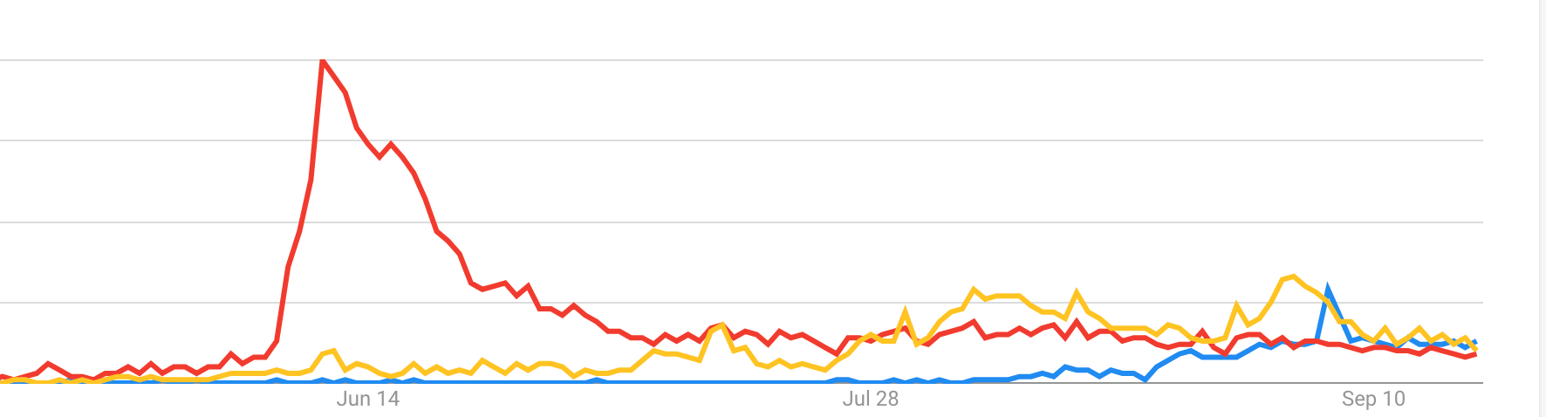
2022 - The Summer of Generative Art
DALL-E
Midjourney
Stable Diffusion
Google Trends for: DALL-E, Midjourney, Stable Diffusion

Slide 7
Terminology
Prompt Engineering
Image Classification
Cat or Dog
Safe or Not Safe
Style Transfer
Inpainting
Outpainting

Slide 8
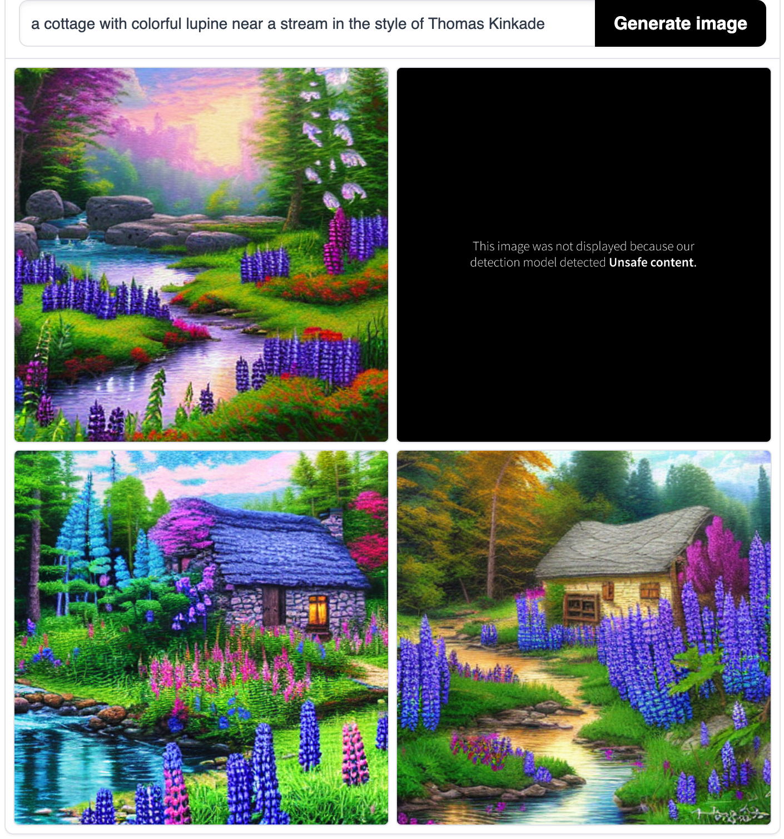
False Positive

Slide 9
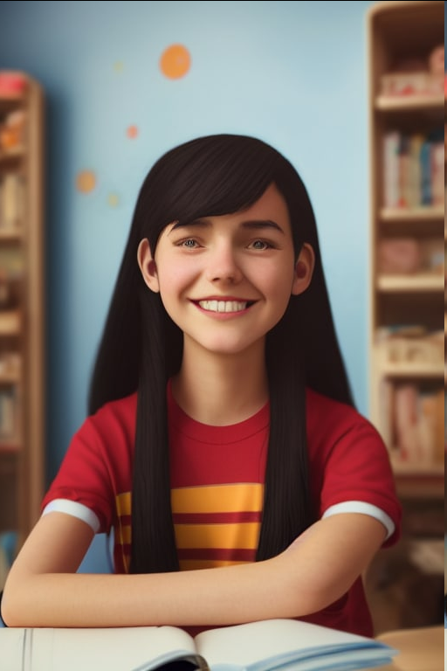
No Hands

Slide 10
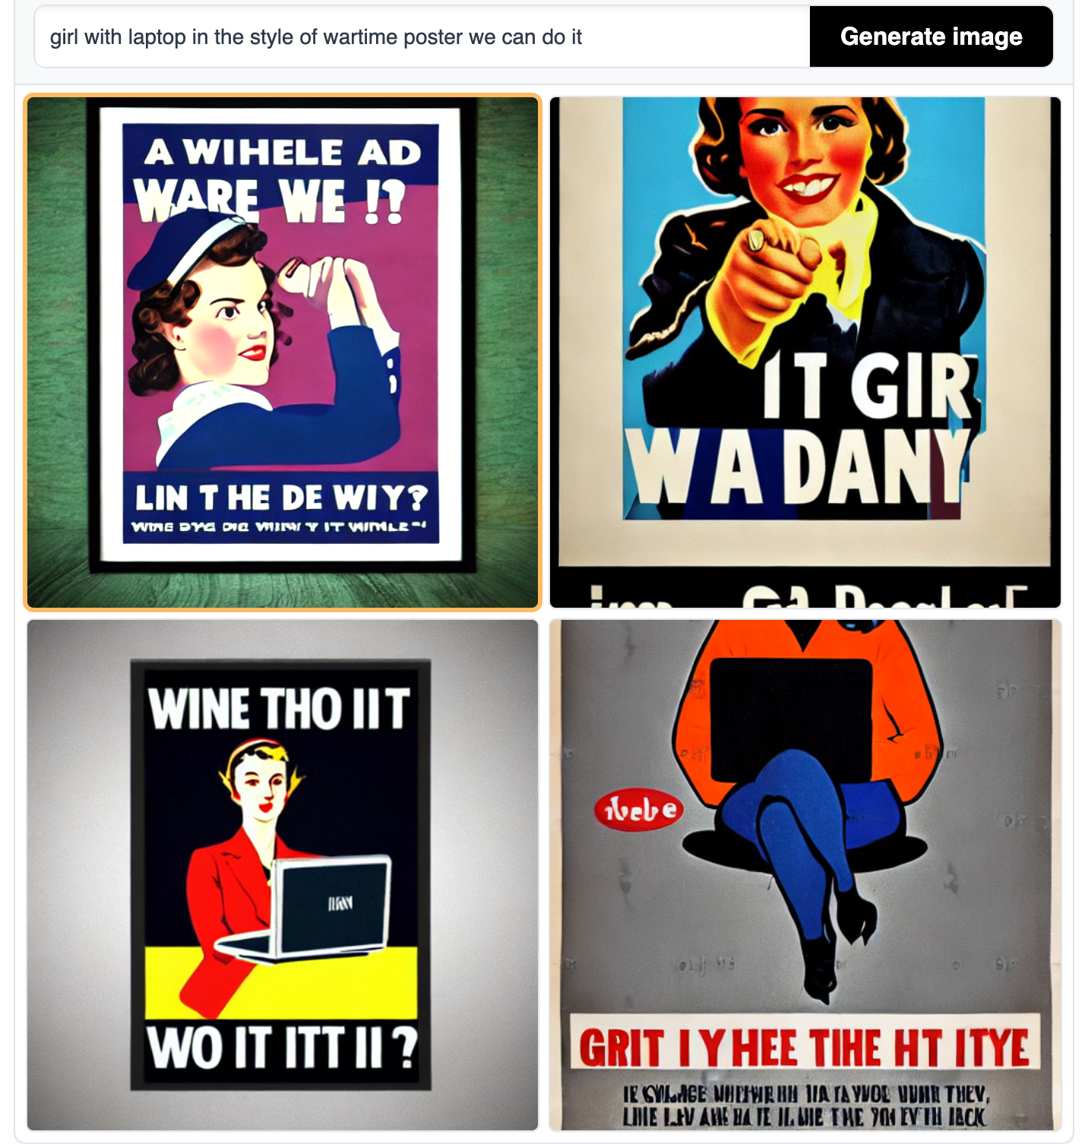
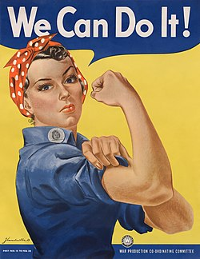
Girl with Laptop in the style of “We Can Do It!”
https://en.wikipedia.org/wiki/We_Can_Do_It!

Slide 11
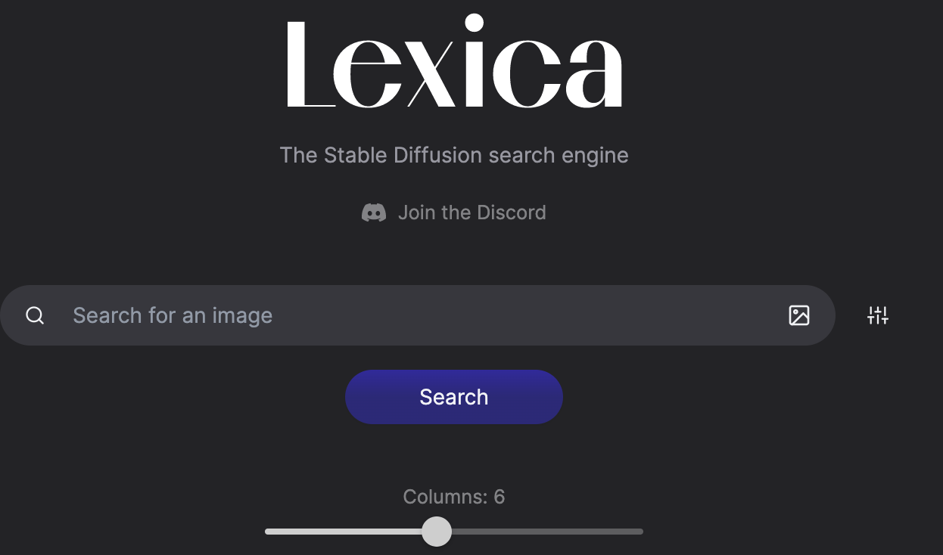
Lexica
Similarity Search

